Slide 1
Microsoft Ignite announcements (November 2021)
Teams, Power Platform, Viva, new products/experiences and SharePoint Syntex
Chris O’Brien
Products & Services Director

Slide 2
Chris O’Brien
www.sharepointnutsandbolts.com
Teams - Ignite announcements (November 2021)
“Teams Connect”
Meeting enhancements
Mesh for Microsoft Teams
Webinar updates
Other
Delayed – preview Q1 2022
Release – “soon”
Preview – first half of 2022
Preview – early 2022
Various
Shared channels across companies – no more tenant switching
Full support for chat, meet, apps and document co-authoring
Also share a channel across multiple internal Teams
Chat with guests using Teams personal accounts (end 2021)
See order of raised hands
Turn off own video
Assign presenter/co-organiser roles when scheduling meeting
Teams Meeting Room enhancements – Direct Guest Join (join a Zoom, Cisco and soon, GoToMeeting and BlueJeans meetings from a Teams Room device)
New MTR devices
Manage Surface Hubs in Teams admin center
Personalised avatars with eye contact and emotions (through Teams live reactions)
Immersive spaces to meet in – conference rooms, lounges, breakout areas etc.
Virtual green room – allow speakers to socialise, monitor chat, do Q&A, share content etc.
Improved control of attendee experience (e.g. hide presenters and shared content until a certain time)
Loop components in Teams (real time co-authoring of notes, lists, tables, tasks etc. which are used elsewhere)
Delayed delivery of chat messages
Improved search experience
Microsoft Editor + Context IQ in Teams – auto suggestions to insert a Loop component, document link, suggested meeting time (based on availability), record from D365 or frequently used info
Chris O’Brien
www.sharepointnutsandbolts.com

Slide 3
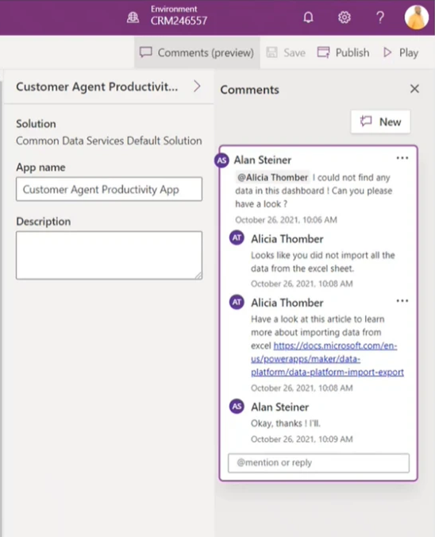
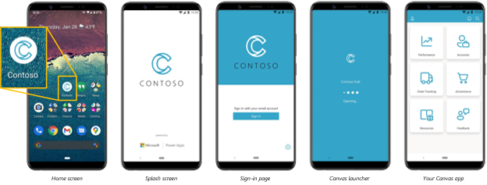
Power Platform – Ignite announcements (November 2021)
Chris O’Brien www.sharepointnutsandbolts.com
New licensing options
Preview – now
PAYG licensing using an Azure subscription - (per app, $10 per user per month)
AI Builder credits now included – 500 for per user, 250 for per app
Power Apps Developer Plan – full premium capabilities for dev/test (free)
Collaborative Power Platform development
Preview – now
Add comments with @mentions (e.g. maker to pro-developer) – available in Power Apps, Power Automate and Power Virtual Agent
Power App co-authoring support through Git providers e.g. Azure DevOps and Github (experimental for now) and support for Github Codespaces
Build NATIVE mobile apps with Power Apps!
Preview - now
Package Power Apps as native mobile apps for iOS/Android, with Intune support
Other app shape developments - “Custom Pages”, add low-code pages to model-driven apps (convergence of canvas/model-driven)
Deeper Teams integration
Release - various
Automate processes with Power Automate templates from Teams app store
Power Virtual Agents – add to a Teams channel, proactively message users, share with security groups (various availability dates)
Power BI app for Teams – now generally available
Improved AI support
Preview - now
Use AI with any Power Apps control
Bring your own AI model and Lobe integration

Slide 4
Microsoft Viva – Ignite announcements (November 2021)
Chris O’Brien www.sharepointnutsandbolts.com
Viva Learning
Now generally available - surfaced through Teams app (desktop and mobile)
Free learning sources - Microsoft Learn, Microsoft 365 Training, subset of LinkedIn Learning and custom SharePoint pages
3rd party LMS integration - circa 12 partners, including Cornerstone, SAP SuccessFactors, Pluralsight etc
Specify learning interests for recommendations, share with colleagues and track completion
Add learning tab to Teams channel
Viva Connections
Now GA, but Teams mobile app updates later in November
Dashboard integrations (adaptive cards) from ServiceNow, Workday, Adobe Sign, DocuSign, Qualtrics, UKG, Blue Yonder and more (now)
OKR module coming in 2022 from Ally.io
Viva Insights
New manager insights and nudges e.g. prompts to praise, set no-meeting times, block focus time etc. for the team.
Effective meetings support - team-level defaults for shortened meetings, feedback requests and auto add Teams meeting links. Also categorise meetings for later analysis (e.g. client, project, internal etc.)
Improved support for focus time and quiet time (out of hours)
Viva Topics
See topic cards in Outlook [OWA initially], Yammer and the user profile card [hashtag integration] (preview end 2021)
See topic cards in Teams [hashtag integration] (preview early 2022)
Improved topic management including segmentation and improved analytics (various dates, all by March 2022)
Multi-lingual support - French, German and Spanish (end 2021)
Viva Topics app in Teams (early 2022)
New features such as topic disambiguation and topic types (Jan-Mar 2022)
Use other sources for knowledge mining - use Graph Connectors for ServiceNow, SQL, Azure etc. (preview by March 2022)
Licensing - Viva full suite license announced - $9 pupm until August 2022

Slide 5
New Microsoft products/experiences announced at Ignite (November 2021)
Microsoft Loop
Mesh for Teams
Context IQ
Ally.io
Clipchamp
PowerPoint Studio
A new “collaborative canvas” app to support teamwork with Teams, Outlook and Office integration
Workspaces, Pages and Components - components are notes, lists, tables or even a Dynamics 365 client record and are “live” wherever they are used (e.g. a Teams chat, e-mail, document or page) – an evolution of Microsoft’s Fluid Framework
Availability:
Live components in Teams, Outlook and OneNote – in Teams now, others end Nov 21
Loop app – “coming months”
Personalised avatars with eye contact and emotions (through Teams live reactions)
Immersive spaces to meet in – conference rooms, lounges, breakout areas etc.
AI-powered “predictive assistance” as you work
Sharing a file – suggest relevant docs based on context
Scheduling a meeting – suggest times when everyone is available
Tagging a colleague – suggestions based on context
Sales – suggest Dynamics client/opportunity data
Other – suggest frequently used info
Implemented in Microsoft Editor first – other experiences later
OKR platform acquired by Microsoft – to become the next Viva module
Set Objectives and Key Results for individuals, teams, divisions or an entire org
Use templates and checklists to drive OKR quality
Collaborative video creation and editing for everyone, using only a browser
Add transitions, filters and stock images/video from built-in library
Camtasia-like templates for YouTube, Instagram, social media, Facebook ads, sales promo videos etc.
Create your own brand kit to apply consistent logos, fonts and colours to your videos
https://clipchamp.com
Record speaking element of presentation with webcam and integrate into slides.
Optionally use PowerPoint Cameo to position video feed to suit individual slide layouts.
Loop component examples: Agenda, Bulleted list, Check list, Numbered list, Paragraph, Status tracker, Table, Task list, Voting table
Chris O’Brien www.sharepointnutsandbolts.com

Slide 6
SharePoint Syntex Ignite announcements (November 2021)
Licensing changes
Content Assembly capability
Syntex contract management
Syntex-powered MIP classification
Use Syntex-based taxonomy for Viva Topics seeding (now)
Prebuilt Syntex AI models
Improved Syntex image tagging – from 37 basic tags to 1000+ for greater accuracy (end 2021)
New pay as you go model to support users who occasionally process documents (Jan 2022) AI model creation for non-licensed users (now)
Use Syntex for content assembly scenarios e.g. contract creation - allow Syntex to create templated documents at scale, using content placeholders and list item values (end 2021)
Specific capabilities for contract management - standard clause libraries, approvals, auto classification and lifecycle management (date unknown)
Apply MIP sensitivity labels automatically through AI document understanding (now)
Improved Syntex/Viva Topics integration
Out-of-the-box AI models for common document types e.g. invoices and receipts (end 2021)
Image tagging support
Chris O’Brien
www.sharepointnutsandbolts.com

